Slide 1
Update on the Drivers of rents project
HTWG May 2022

Slide 2
Outline
Literature review
Data availability
Forward plan

Slide 3
Literature review
Research on drivers of rents are quite limited, both internationally and in NZ
The majority of research has been focused on drivers of house prices
Rents tend to enter the equation as given or projected fixed annual increase
However, as the rental has similar products, it's possible to replicate previous studies on house prices using rent prices as dependent variable

Slide 4
Models
VAR
Reduced-form OLS
Spatial equilibrium

Slide 5
Potential drivers
Variable | Sign | Channel | Notes | Countries | Models
Income/Wage | + | Renters’ ability to pay | Useful to differentiate the impact of income (across all) vs wage (working people) and personal vs household (endogenous to household choices) | All (US/NZ/Aus) | OLS/VAR
Relative supply and demand: People per dwelling Population Internal migration Number of dwellings Vacancy rate Unemployment rate (through desirable household size) | + |  | Include supply and demand variables separately 2-stage approach: Estimate relative supply and demand gap (vacancy rate or people per dwelling) separately | All (US/NZ/Aus) | OLS/VAR

Slide 6
Variable | Sign | Channel | Notes | Countries | Model
Lagged rent inflation | + |  |  | All | VAR/OLS
Interest rates | + | Homeownership rate Cost of owning Expected capital gains Supply response Restricted land market | Some claim that it explains part of the “price puzzle” from monetary policy shocks | US | VAR
House prices | + | User cost NPV of rents Rental supply | Potentially with lags due to reverse causality issue | US | VAR/OLS
General inflation | + | Expenses Indirect through wage inflation | Inflation less rents Core inflation | US
Internal migration (population elasticity to rents / cross-cities population elasticity to rents) | + | Location demand | How do we define “local” housing market If all elastic, it does not matter where supply is | US/NZ | VAR/OLS/Spatial equilibrium
Interactions of two or more of the above |  |  | Almost everything interacts with supply and demand
Notes:
Interest rates (Rents are a big part of CPI)

Slide 7
Data availability
Data | Sources | Frequency | Variables | TA/Regional level | Notes
Rental Price Index | Stats | Monthly | RPI stock and flow | Yes | Some TAs are too small (too few repeated transactions) to construct timeseries of index
Tenancy bond data | MBIE | Monthly | Active bonds, New bonds, Median/Geometric mean rents, | Yes
Number of dwellings | Stats (Census + consents) | Quarterly/Monthly | Number of dwellings | Yes
 | Electricity Authority | Monthly |  | National only
 | HUD | Monthly |  | Yes
Income/wage | Stats/HUD | Monthly | Average household income, average weekly earnings | Yes | Some modelling may involved in creating regional/TA series
House price | Corelogic/REINZ/HUD | Monthly | House price index | Yes
Notes:
Vacancy = listings (Trade Me)/bonds (MBIE)
Should be alright if we assume TM’s market share equals MBIE’s bonds share of all tenancies

Slide 8
Data | Sources | Frequency | Variables | TA/Regional level | Notes
Internal migration | Stats NZ (admin data) | Yearly | Inward and outward migration between regions/TAs | Yes | Constructed from IDI, not published
Other macro indicators | Stats NZ | Quarterly | CPI CPI less rents Unemployment rate | No
Short-term listings | InsideAirBnB | Quarterly/Monthly | Web-scraped data on Airbnbs; number, location, property type, bedroom size, availability, host size, price. | Yes | Other sources of short-term rental are missing (e.g bookaback, etc)
Trade Me listings (for vacancy measure) | TM | Monthly | Number of listings, views/ enquiries | Yes? | Too sensitive to TM's market share Regional/TA coverage is inconsistent
Building consents | Stats | Monthly | Building consents issued | Yes

Slide 9
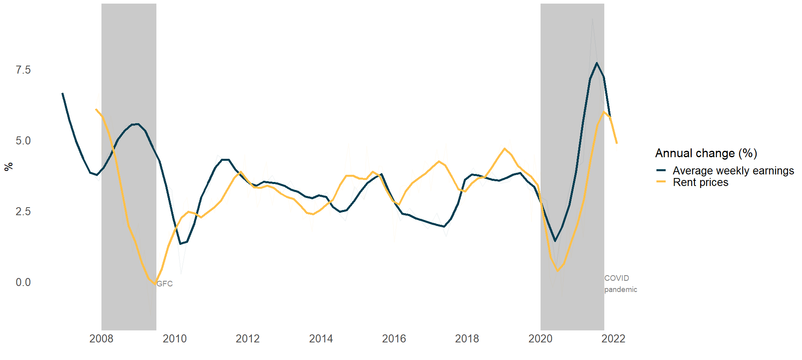
Income vs rent

Slide 10
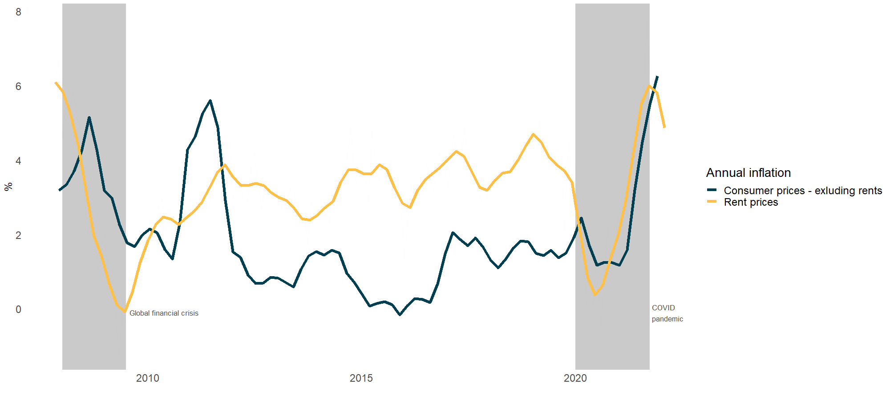
CPI less rents vs rents

Slide 11
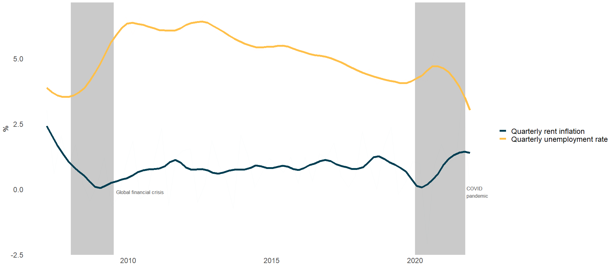
Unemployment vs rents

Slide 12
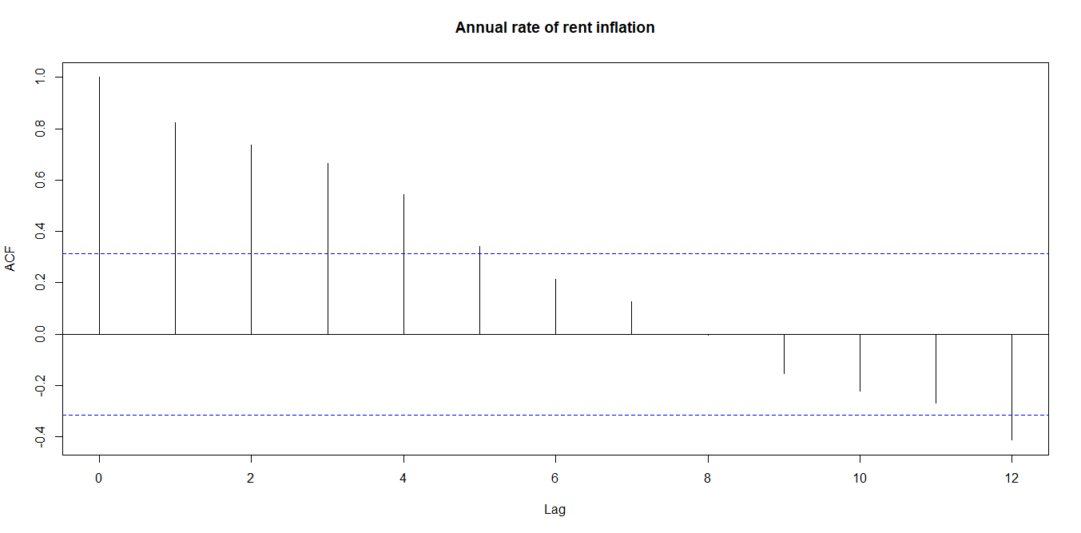
Lagged rents vs rents

Slide 13
People per dwelling vs rents

Slide 14
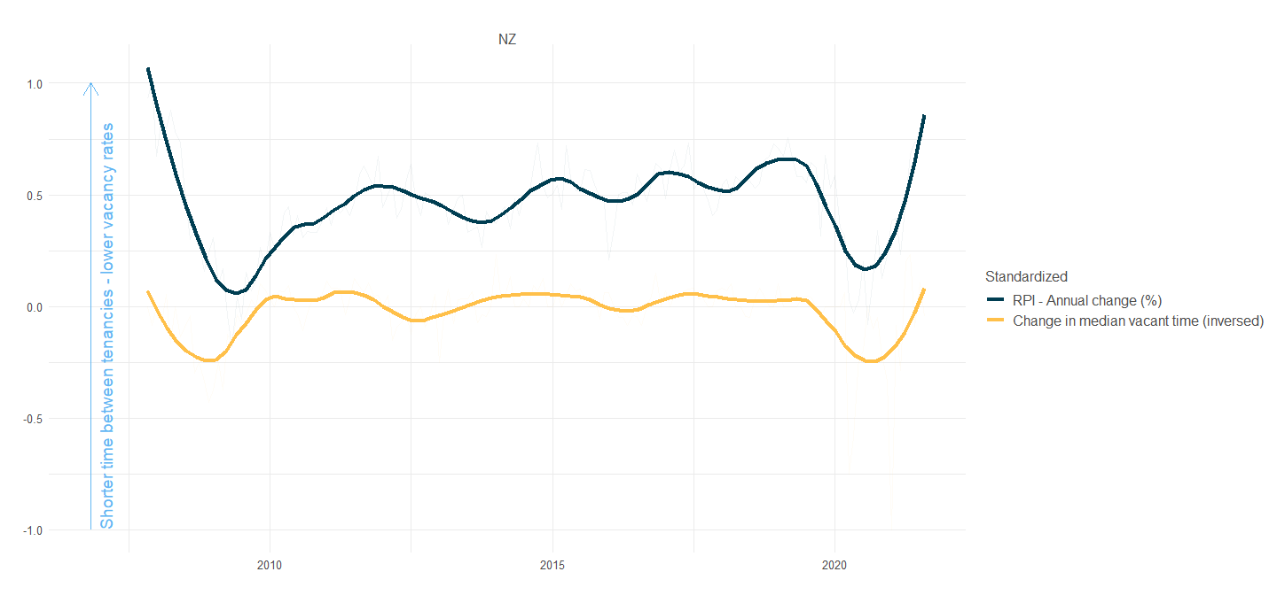
Vacancy rate vs rents

Slide 15
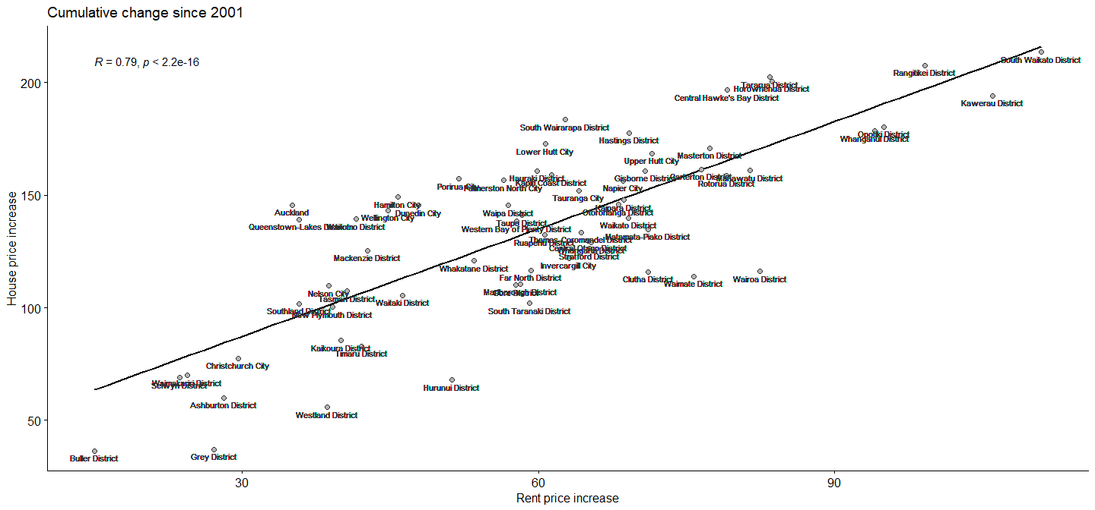
House prices vs rents

Slide 16
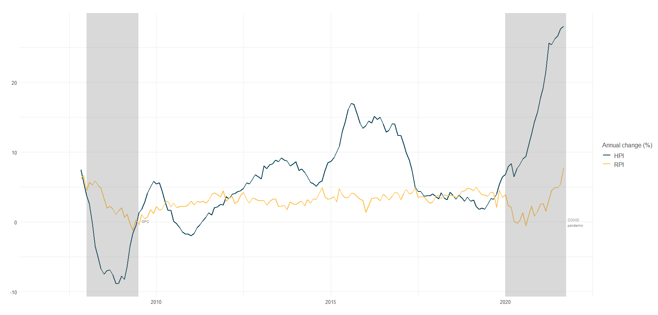
House prices vs rents

Slide 17
Next steps
Reduced-form OLS/VAR at national level with potential drivers (and appropriate lags)
Panel regression at region/TA level

